Slide 1


Titolo presentazione sottotitolo
Performance Evaluation and Applications
Milano, XX mese 20XX
Luca Longinotti

Slide 2
Introduction
Student: Luca Longinotti
Codice persona: 10707342
Matricola: 937218
QR-code ID: 22531522
Project type: C

Slide 3
I Phase: Fitting
At the beginning, I studied different service times to calculate the best distribution to use for each department.
I used Matlab and I have evaluated the coefficents of variation; this helped me to choose the correct distribution faster.
Distributions adopted for each department :
Formalize specifications → Erlang
Design hardware → Erlang
Breadboard hardware → HyperExponential
Write software → HyperExponential
Test → Exponential

Slide 4
II Phase: Simulation
I used JMT to simulate the system.
I adopted a closed model with 1 class, a delay and 5 queues; I added also a fork node and join node in order to ensure that a project has completed both branches before starting the testing phase.
I compiled all the parameters of each station through data calculated in Phase I.
I setted the What-If analysis parameters (population between 1 and 10) and I calculated the best ratio of System Throughput (ST) to System Response Time (SRT) using results of simulation.
This calculation led me to know the best N to use.

Slide 5
Results and Conclusion
N = 1 → ST / SRT = 1.50 x 10^-13
N = 2 → ST / SRT = 2.00 x 10^-13
N = 3 → ST / SRT = 2.02 x 10^-13
N = 4 → ST / SRT = 1.87 x 10^-13
N = 5 → ST / SRT = 1.66 x 10^-13
N = 6 → ST / SRT = 1.54 x 10^-13
N = 7 → ST / SRT = 1.39 x 10^-13
N = 8 → ST / SRT = 1.28 x 10^-13
N = 9 → ST / SRT = 1.20 x 10^-13
N = 10 → ST / SRT = 1.07 x 10^-13
Conclusion:
In order to produce the best tradeoff between throughput and project completion time, the best number of projects N is 3.

Slide 6
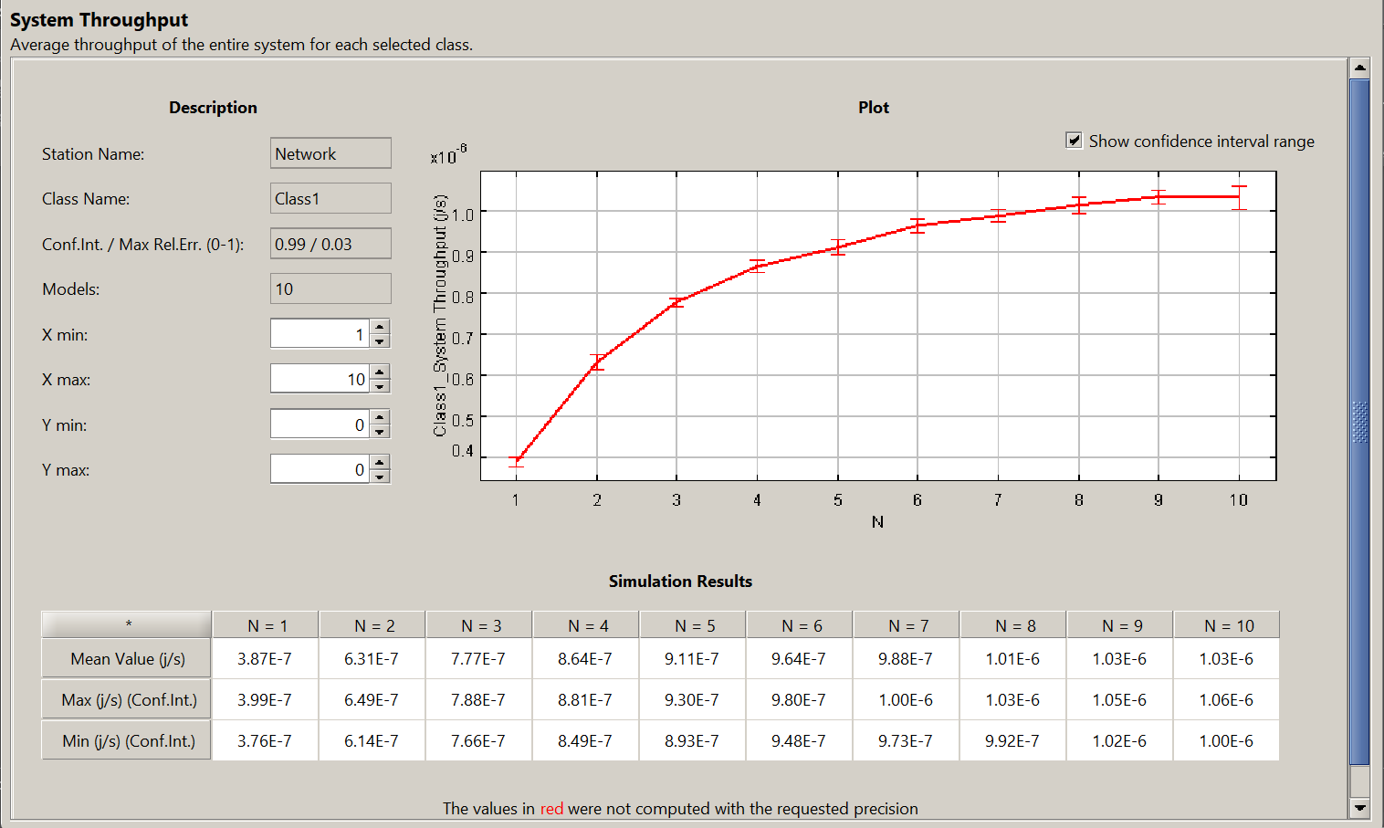
System Throughput

Slide 7
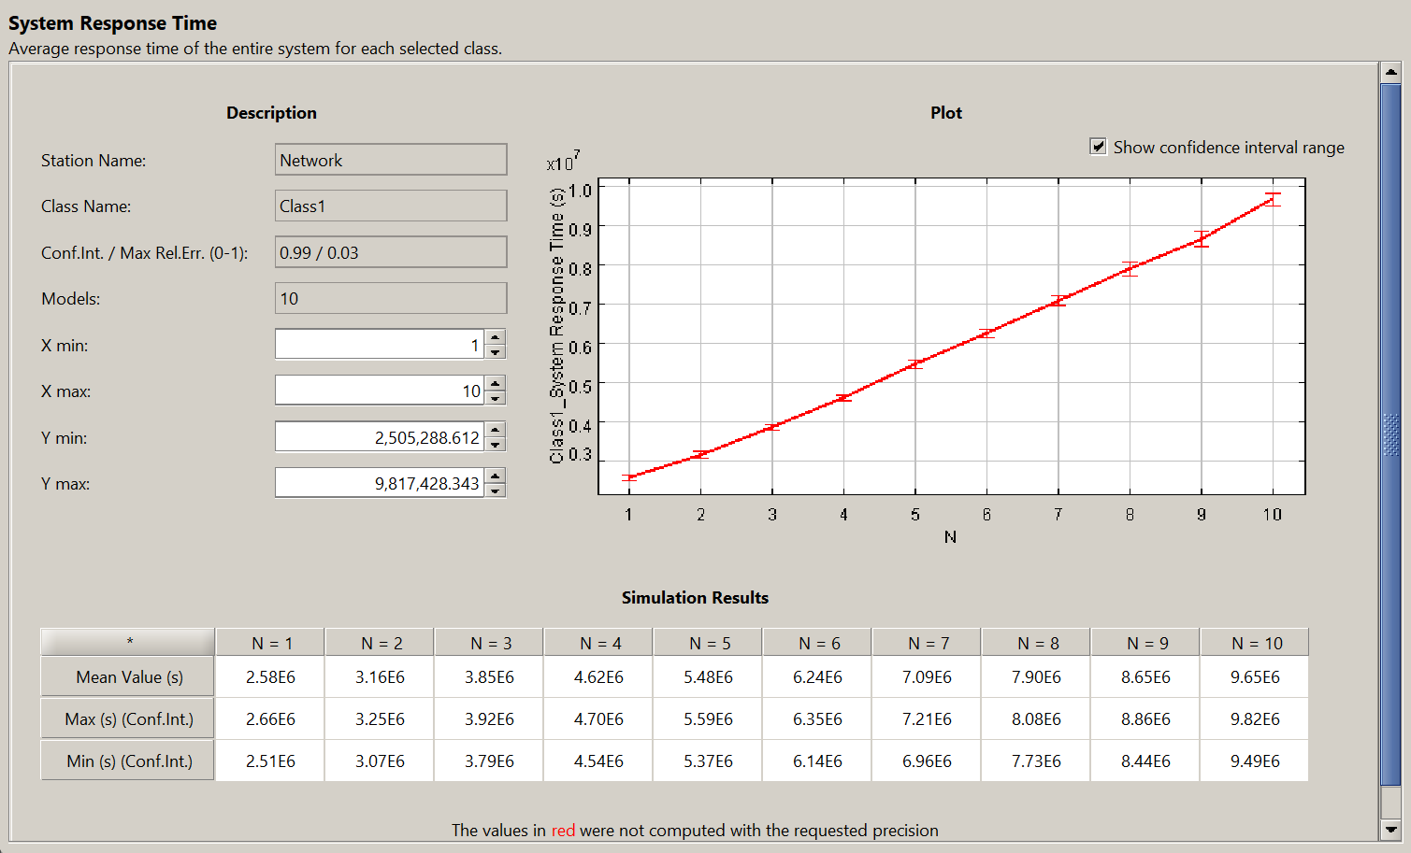
System Response Time

